Slide 1
Travel PLANNER agent
IBM AICTE PROJECT
Presented By: YASHVITHA K N
College Name & Department : INTERNATIONAL SCHOOL OF MANAGEMENT EXCELLENCE - MCA

Slide 2
OUTLINE
Problem Statement
Technology used
IBM Cloud services used
Wow factor
End users
API Reference After Deployment
Deployment & Preview
Results
Conclusion
Git-hub Link
Future scope
IBM Certifications

Slide 3
Problem Statement
Design and build an AI-driven Travel Planner Agent that:
Creates travel plans tailored to user preferences.
Recommends destinations and generates customized itineraries.
Suggests transportation and lodging options.
Integrates real-time data such as weather, maps, and local events.
Handles bookings and provides timely alerts.
Dynamically adjusts schedules for optimal planning.

Slide 4
Technology used
IBM cloud lite services
Natural Language Processing (NLP)
Large Language models (LLM)
IBM Granite model
IBM App Connect

Slide 5
IBM cloud services used
IBM Cloud Watsonx AI Studio
IBM Cloud Watsonx AI runtime
IBM Cloud Functions
IBM Cloud service
IBM Granite (via watsonx.ai studio)
IBM Cloud Object Storage
IBM AI Tools

Slide 6
Wow factors
The Travel Planner Agent provides powerful capabilities, including real-time itinerary adjustments in response to weather changes and travel disruptions, ensuring a hassle-free travel experience. Leveraging the advanced AI of IBM Granite, it accurately interprets user inputs to deliver deeply personalized travel plans. The agent intelligently suggests destinations and routes aligned with individual preferences, budgets, and constraints. Its seamless integration with IBM Cloud services creates a smooth, conversational interface that transforms complex travel planning into a simple, user-friendly process.
Key features:
Dynamic itinerary updates based on live weather conditions and travel status.
Personalized recommendations through natural language understanding powered by IBM Granite.
Customized destination and activity suggestions based on user interests, budget, and trip length.
Integrated access to maps, weather, and booking data for unified planning.
Efficient serverless backend powered by IBM Cloud Functions.
Conversational, chat-based interaction enabled by Watson Assistant.

Slide 7
End users
Solo travelers.
Travel content creators and influencers.
Travel companies providing personalized itineraries.
Corporate professionals organizing multi-destination journeys.
Scholars or researchers traveling for academic purposes.

Slide 8
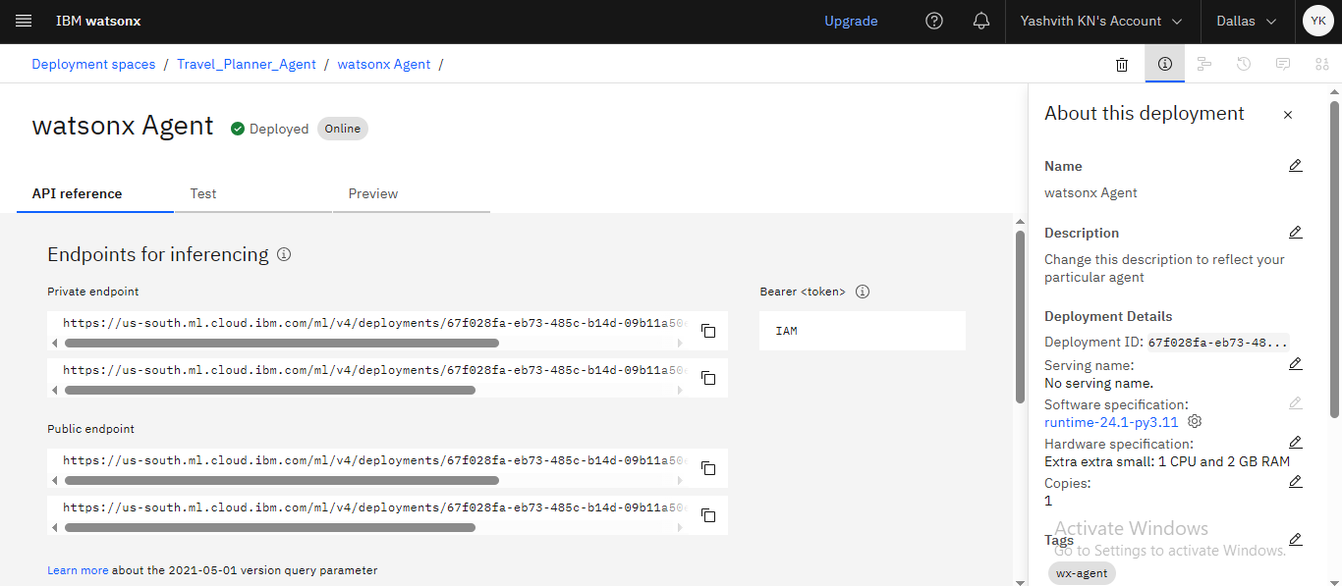
API REFERENCE AFTER DEPLOYMENT

Slide 9
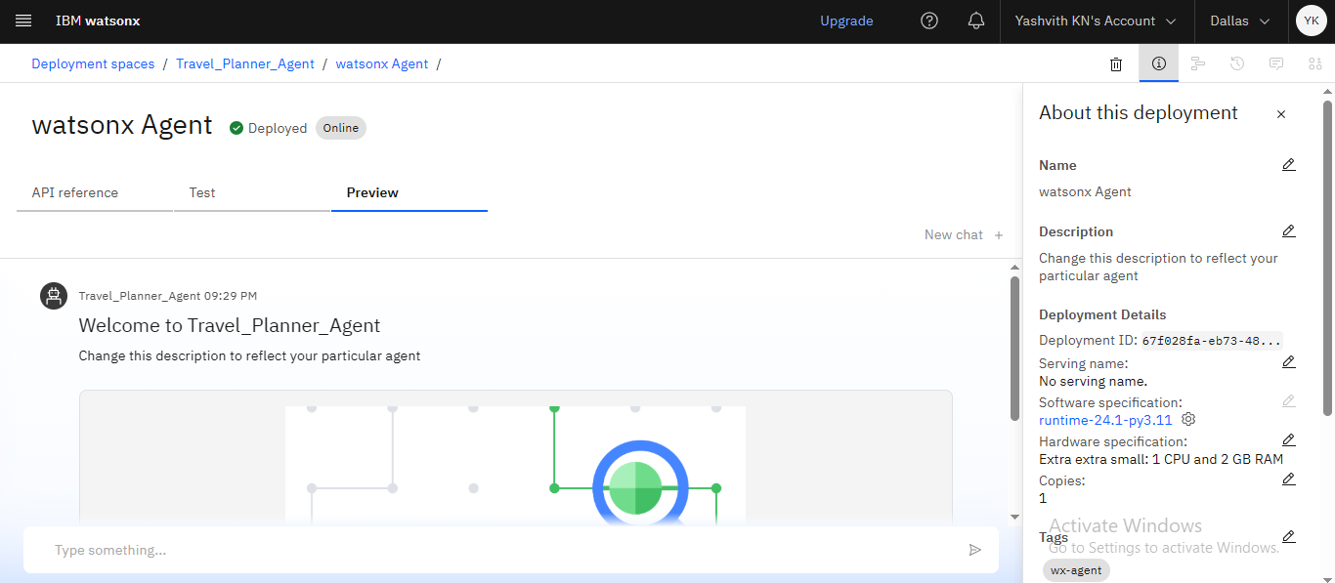
DEPLOYMENT & PREVIEW

Slide 10
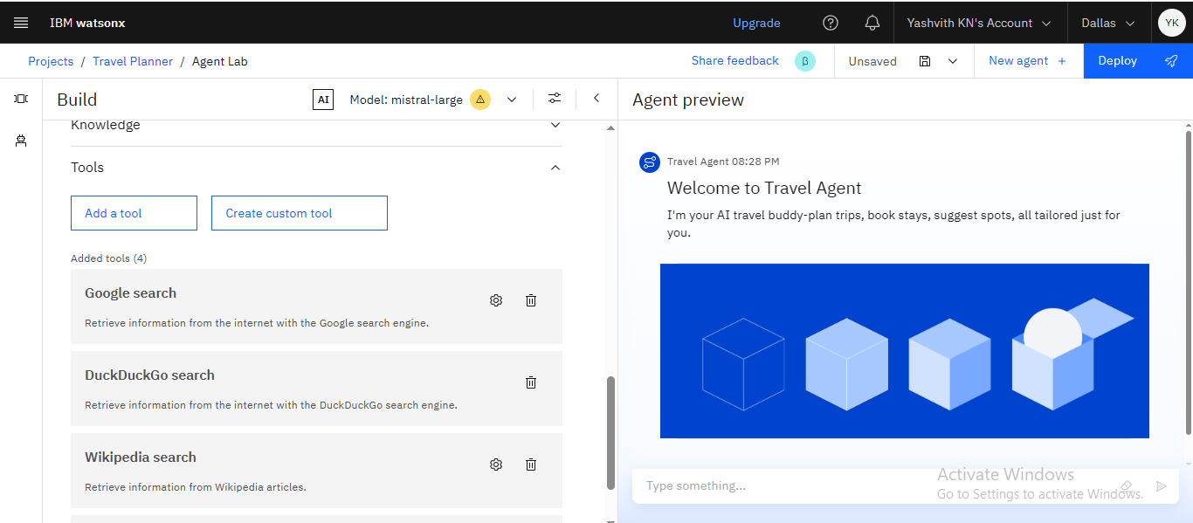
Results

Slide 11
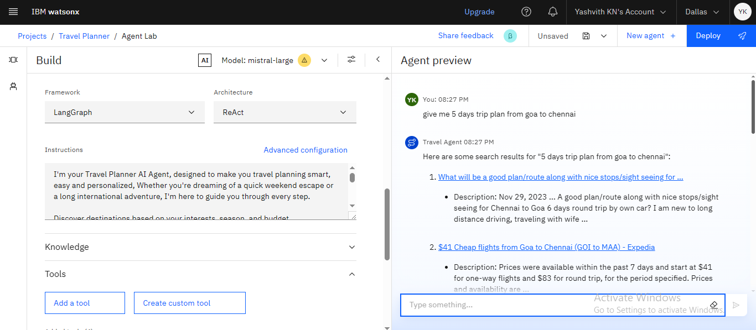
Results

Slide 12
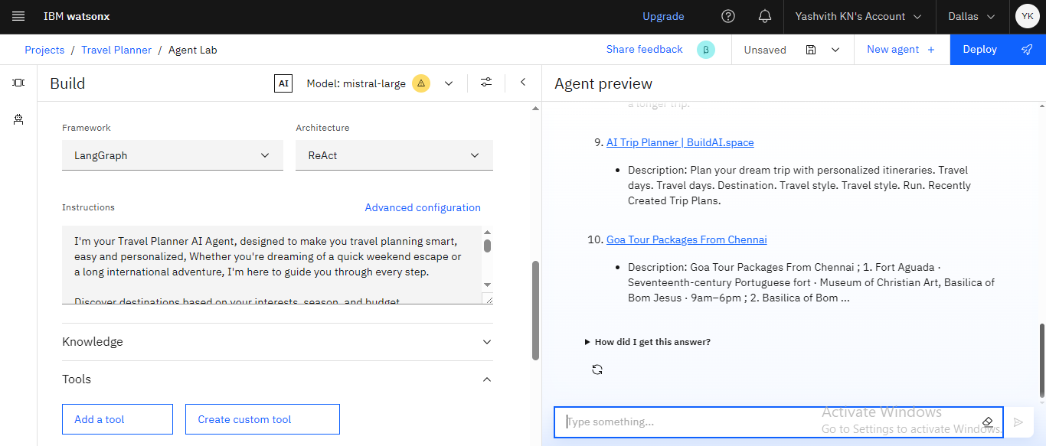
Results

Slide 13
Conclusion
The Travel Planner Agent simplifies the complexities involved in trip planning.
Utilizing IBM Cloud AI services, it provides real-time, personalized, and adaptive travel solutions, enabling users to experience a seamlessly organized journey.
This demonstrates a practical use of AI in addressing real-world logistical challenges while maintaining a user-friendly and efficient experience.

Slide 14
GitHub Link
https://github.com/YashvithaKN/TRAVEL-PLANNER-AGENT-IBM-PROJECT.git

Slide 15
Future scope
Links to booking platforms (such as Skyscanner and Airbnb)
AR-powered virtual destination tours
Integration with voice assistants (e.g., Alexa, Siri)
Location-based emergency assistance and alerts
AI-driven budget optimizer to maximize experiences within a user’s budget
Community features offering peer recommendations
Watson Language Translator–enabled multilingual support
Offline access for areas with limited connectivity

Slide 16
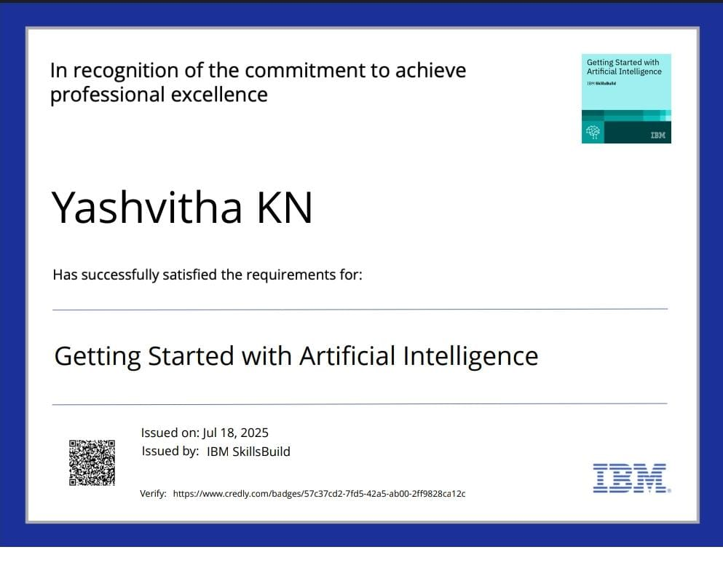
IBM Certifications

Slide 17
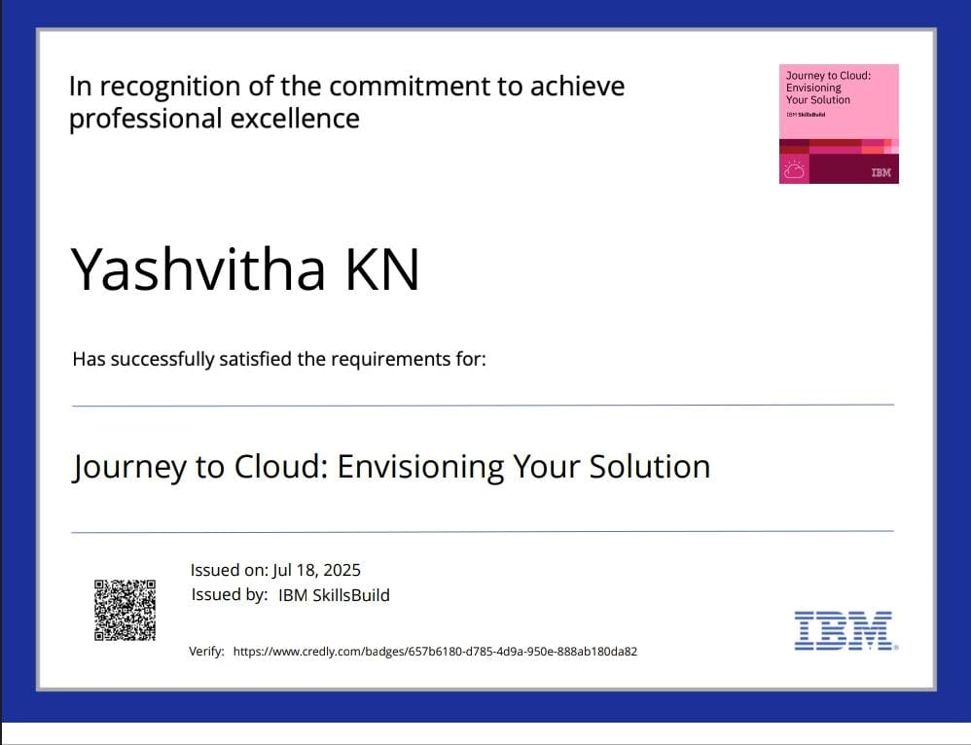
IBM Certifications

Slide 18
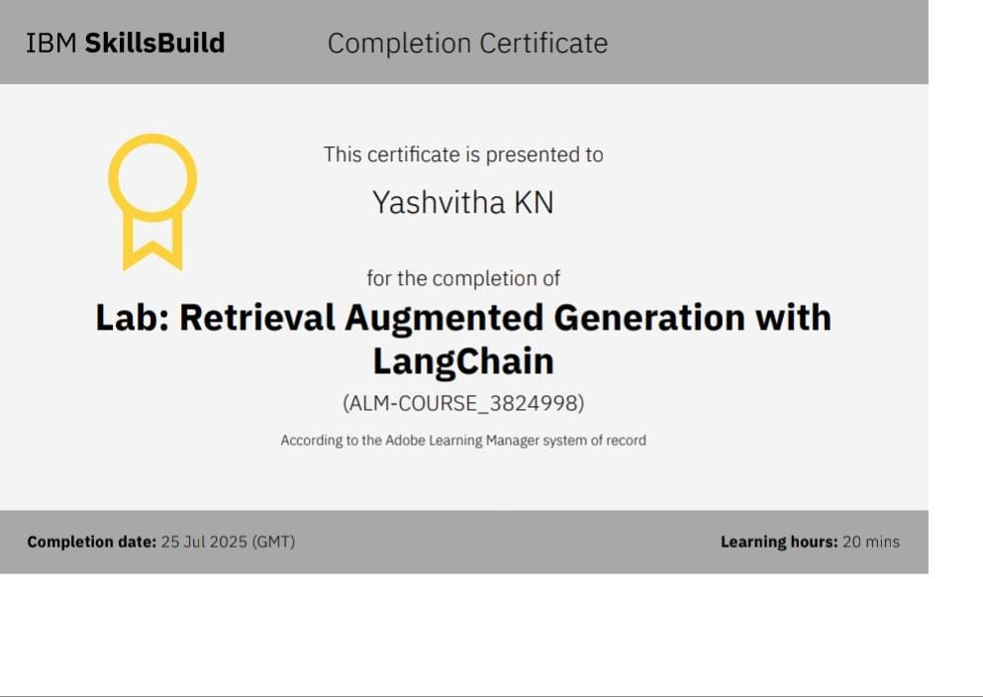
IBM LAB CERTIFICATE

Slide 19
THANK YOU

